Slide 1
Intro to methods of measuring concurrent entrainment

Slide 2
How can we measure the association between two signals?

Slide 3
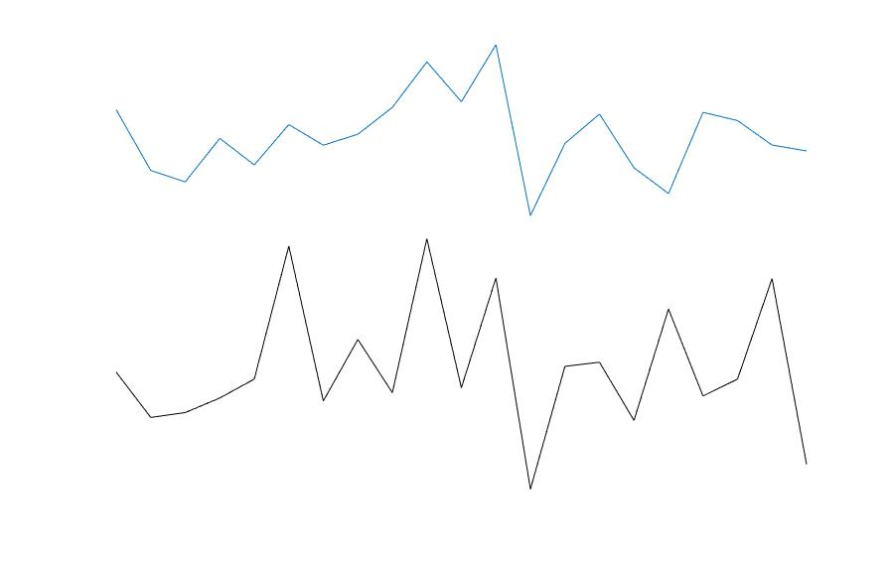
How correlated are these signals

Slide 4
How correlated are these signals at each time lag?
What is the peak ‘time lag’ of the association between these signals

Slide 5
1
5
7
3
11
2
9
9
Sum( 1*11, 5*2, 7*9, 3*9 )
Same as a.b

Slide 6
1
5
7
3
11
2
9
9
Association at -1 (samples) lag

Slide 7
0 0 0 0
0
1
5
7
11
2
9
9
Sum( 0*11, 1*2, 5*9, 7*9 )
Association at -1 (samples) lag

Slide 8
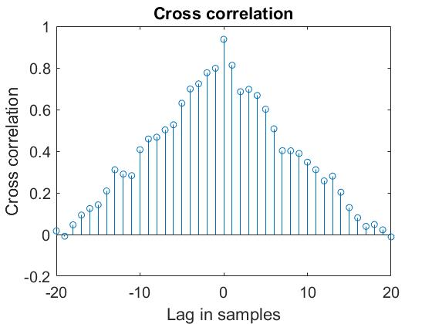

Slide 9
Switch over to MATLAB for first set of exercises

Slide 10
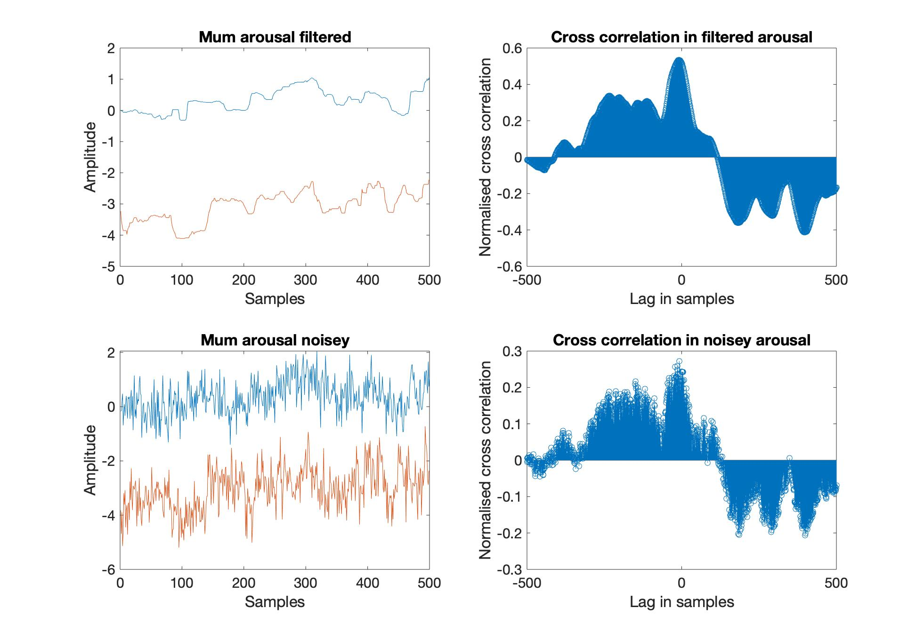
Impact of variability (noise)

Slide 11
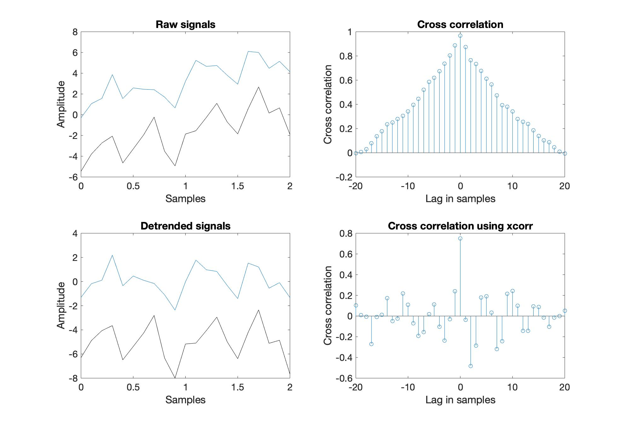
Impact of linear trends

Slide 12
Break: 20mins

Slide 13
How can we measure the association between two signals at specific frequencies?

Slide 14
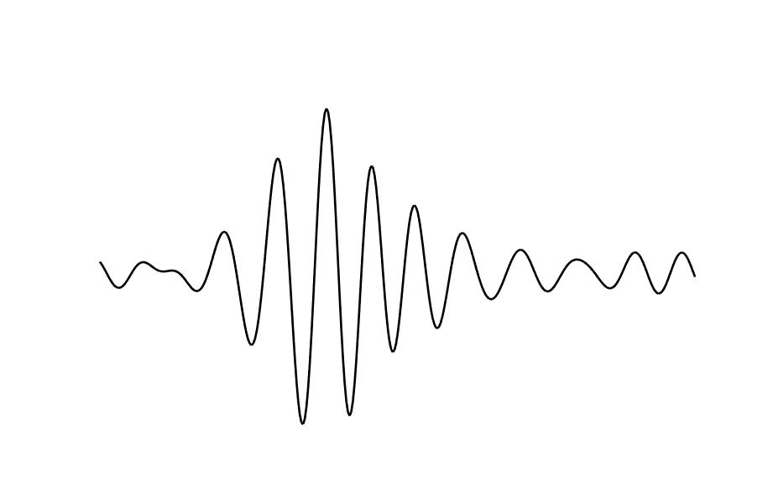
Different signal properties
Frequency
How fast?
Phase
Where?
e.g.,
‘theta’
4-8Hz
Power
How strong?
Important to note as different types of entrainment can/ are applied to different aspects of signal

Slide 15
How can we extract power and phase information?

Slide 16
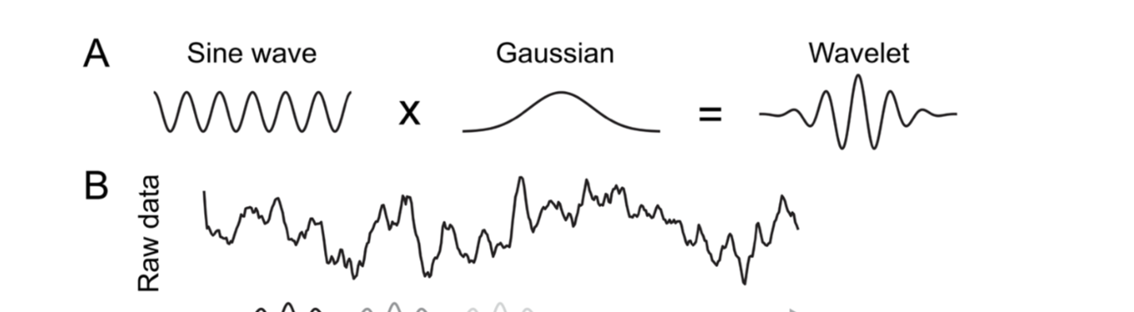
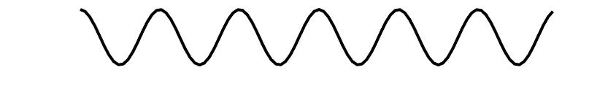
FFT
3Hz sine wave
Dot product
Result:
Power at 3Hz

Slide 17
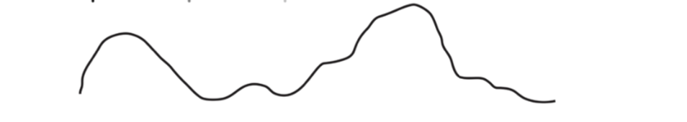
This gets moved along in time
Dot product/ convolution
Result of convolution

Slide 18
Phase
Phase refers to where in its cycle an oscillator is
Phase angle
Whereas Phase angle refers to the angle between the vector and the x (real) axis

Slide 19
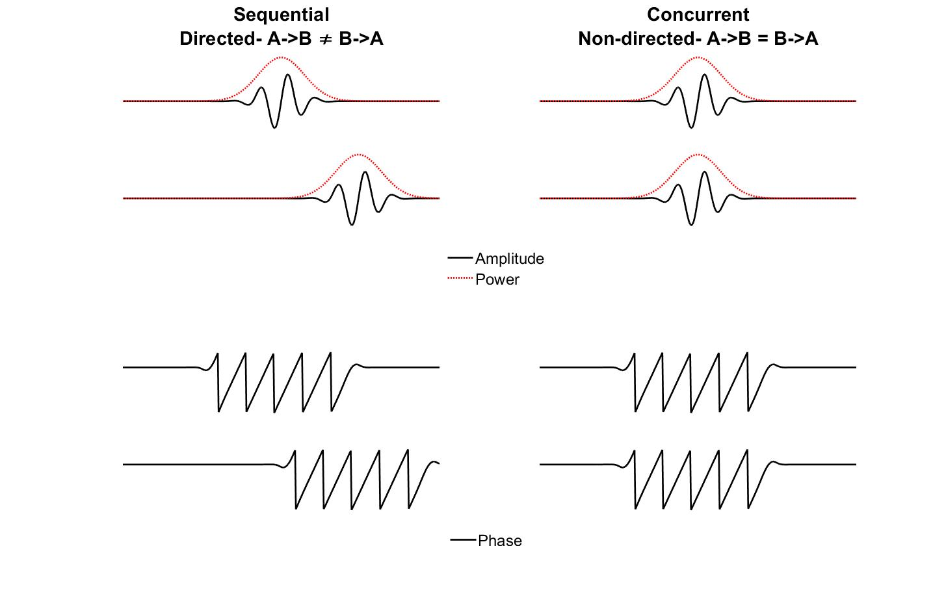
First, concurrent IBE indexes a zero-lag, simultaneous relationship and is undirected: A->B is indistinguishable from B->A.
Often referred to using the term ‘synchrony’,
e.g., for entrainment in amplitude/power for example this could indicate ‘at times when A is high, B is also high’ or (for a negative relationship): ‘at times when A is high, B is low’.
Or for phase this could indicate ’a consistent relationship between the phase of A and B over time’

Slide 20
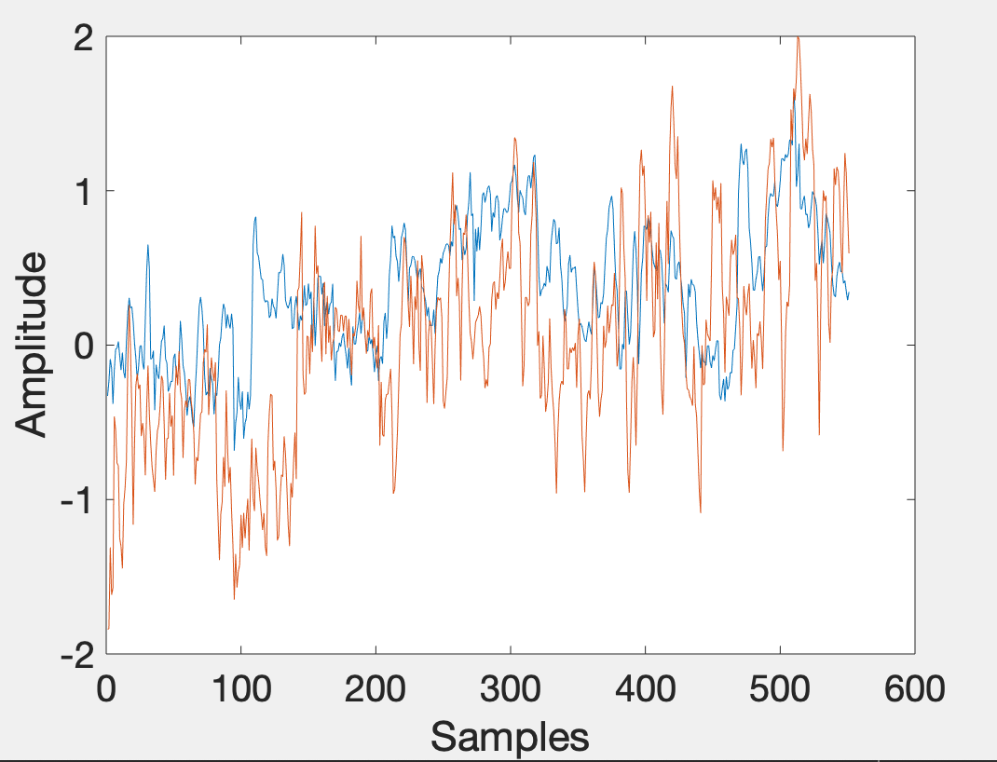
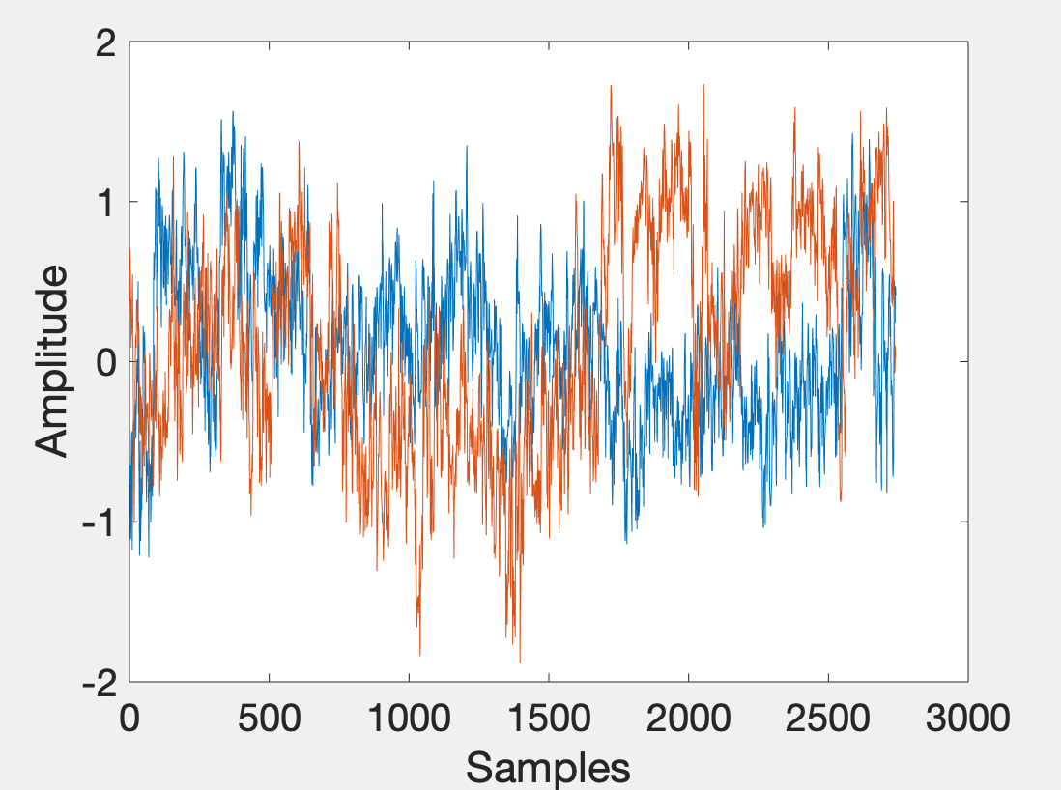
Correlations in amplitude/power over time

Slide 21
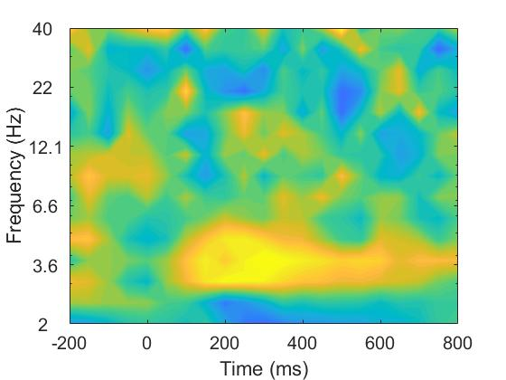
Correlations in amplitude/power over time
Notes:
Examining concurrent IBE through correlations is one of the simplest and most flexible techniques. Zero-lag concurrent IBE can simply be measured by calculating correlation coefficients between two time series. Spearman’s correlation is generally favoured due to its invariance to non-normally distributed and outlier prone data (Cohen, 2014). The same analysis can be applied either to the amplitude of the brain signal or to the power in particular frequency bands. The accompanying code for this section allows the reader to compute single-trial correlations (Spearman’s rho) at each time-frequency point, between pairs of electrodes (e.g., using data from Cz from person one and Cz from person two).

Slide 22
Phase locking
Operationalized as the mean difference between the phase angles of two time series.
Can be computed (mean) over repeated events or over time – sliding window approach

Slide 23
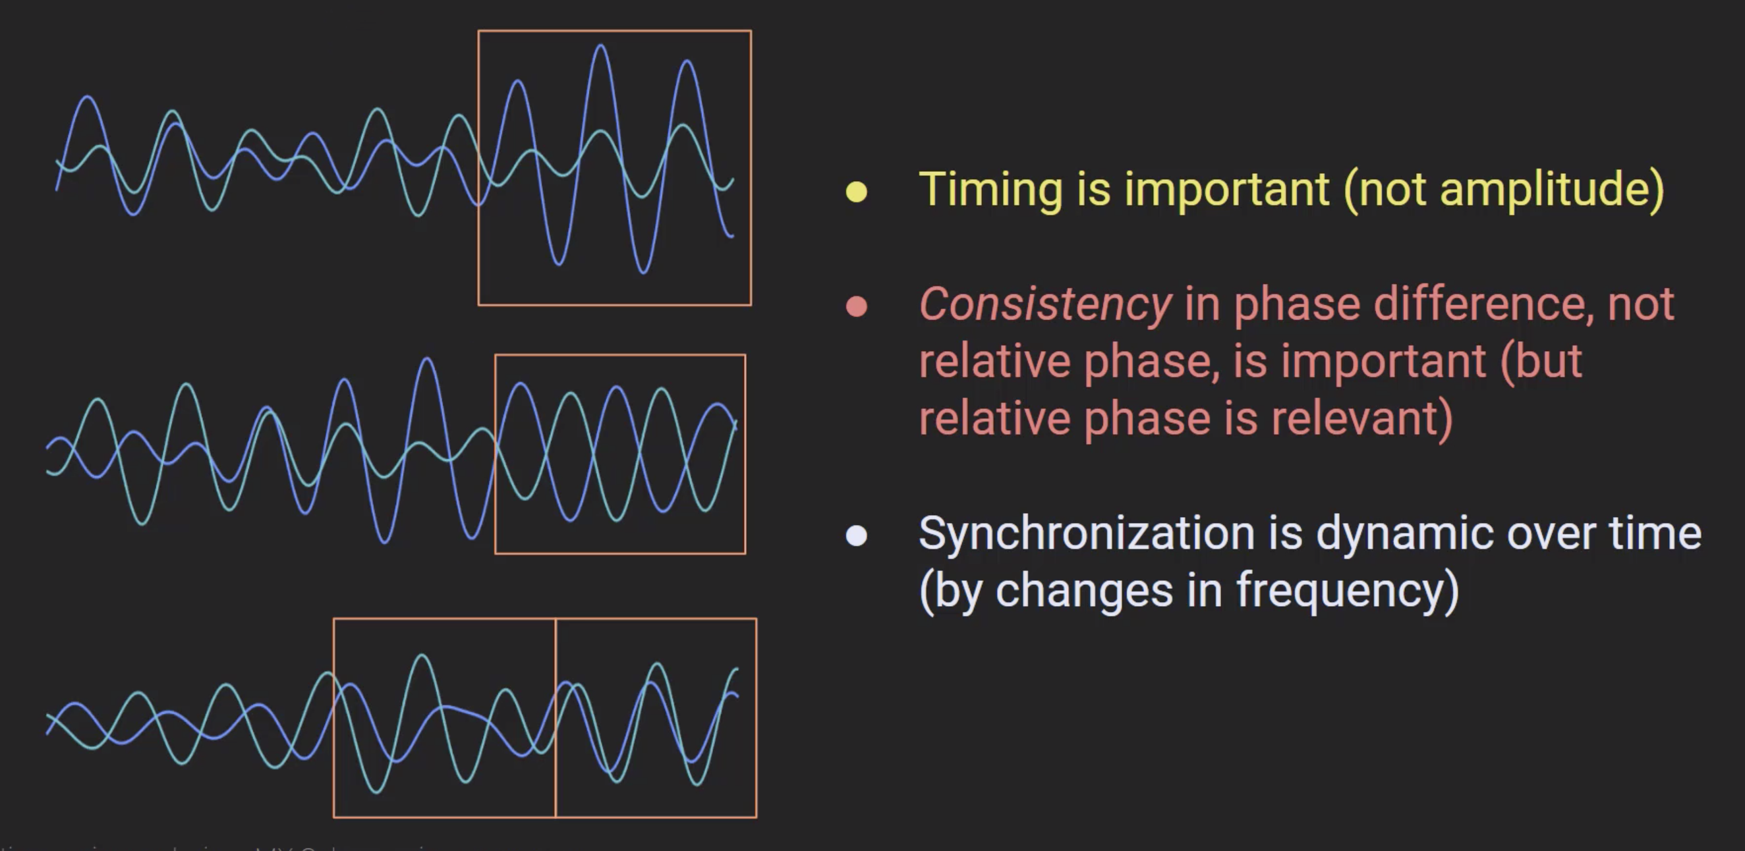
Phase locking

Slide 24
Timing is crucial
Intuition about synchronization tells us that it is dynamic over time.
Inter brain neural synchronization is usually studied as a time invariant data feature.
This limits our understanding of how mechanistically this synchronization might be established/ maintained.

Slide 25
Switch over to MATLAB for second set of exercises

Slide 26
What are some of the pitfalls associated with methods of concurrent entrainment?

Slide 27
1. Shared entrainment to environment
How do we asses the live social determinants for IBE? For example, would you observe same level of IBE entrainment if both participants performed same task in isolation?
Concurrent entrainment is very susceptible to this.

Slide 28
Relationship between power and phase
In general power and phase are independent.
ERP’s are phase locked activity.
This means ERP’s will typically show as increases in time frequency power and phase locking.
Can be tricky to interpret phase changes when simultaneously occur with power changes.
Further complicated as large changes in SNR can drive down error in estimating phase and give the appearance of changes in phase locking.

Slide 29
Conclusion
We have learned about assessing associations in signals using (cross) correlation.
We have learned how to extract power and phase from signals and use to compute measures of concurrent entrainment.
We have discussed some of the caveats associated with these analysis.

Slide 30
Break: 15mins

